Slide 1
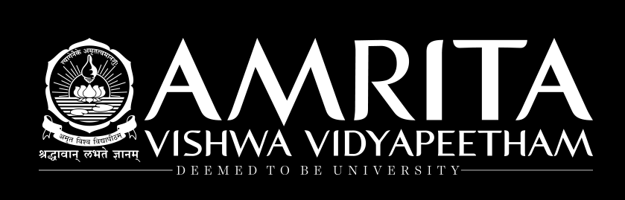

AutoEncoders

Slide 2
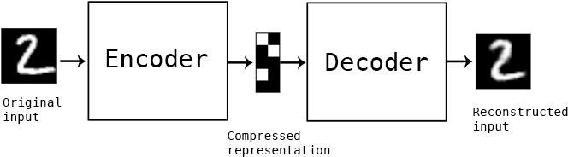
What is an Autoencoder?
Autoencoders are neural network-based models that are used for unsupervised learning purposes to discover underlying correlations among data and represent data in a smaller dimension. The autoencoders frame unsupervised learning problems as supervised learning problems to train a neural network model.
Dimensionality Reduction
The reason behind using an autoencoder is that we want to understand and represent only the deep correlations and relationships among data
latent feature space
The input is squeezed down to a lower encoded representation using an encoder network, then a decoder network
decodes the encoding to recreate back the input.
The encoding produced by the encoder layer has a lower-dimensional representation of the data and shows several
interesting complex relationships among data.

Slide 3
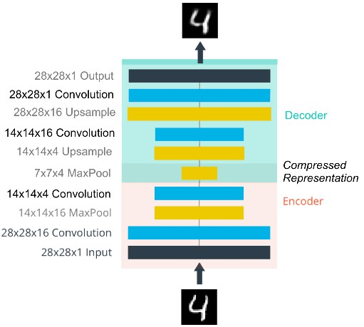
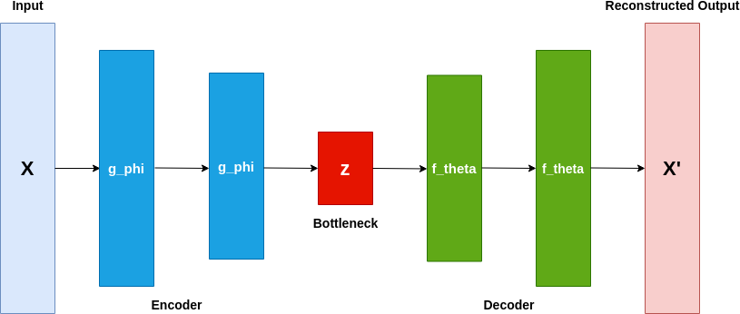
Auto-encoder- Parts
An Autoencoder has the following parts:
Encoder: The encoder is the part of the network which takes in the input and produces a lower Dimensional
encoding
Bottleneck: It is the lower dimensional hidden layer where the encoding is produced. The bottleneck layer has a lower number of nodes and the number of nodes in the bottleneck layer also gives the dimension of the encoding of the input.
Decoder: The decoder takes in the encoding and recreates back the input.
Courtesy : https://towardsdatascience.com/

Slide 4
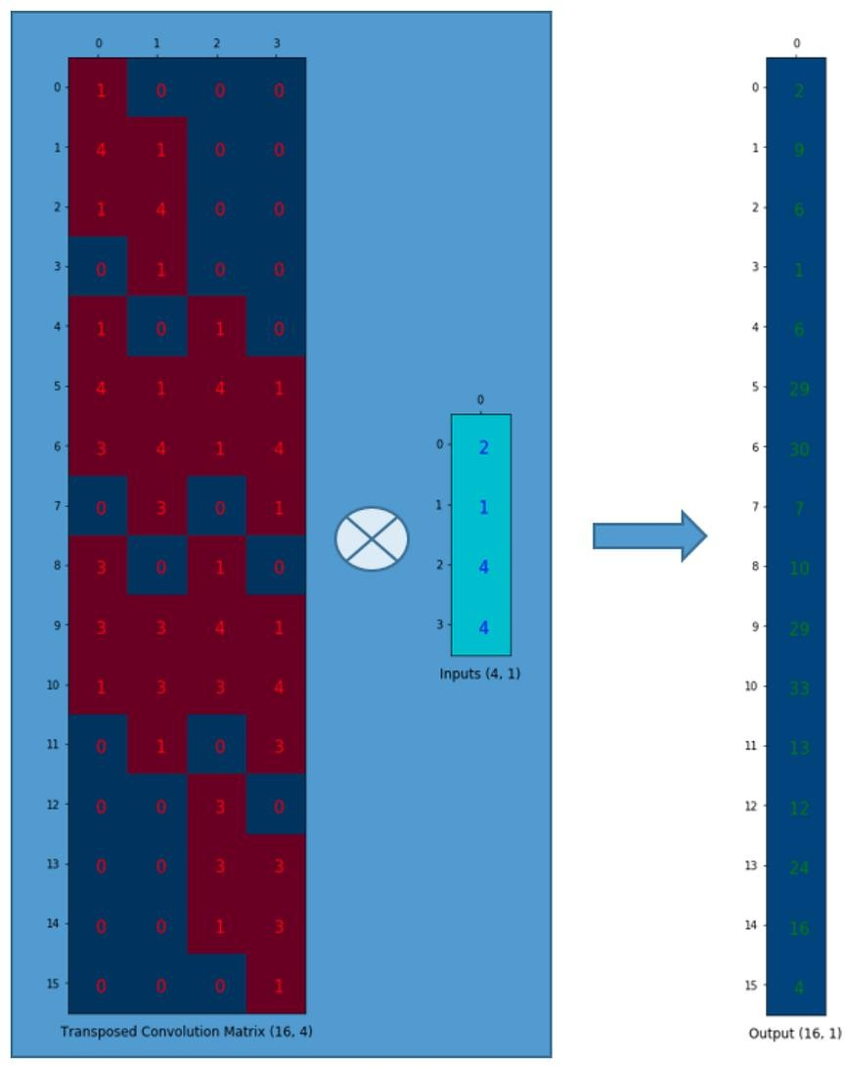
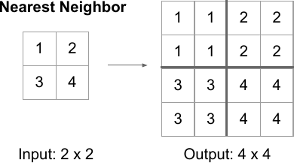
Upsampling
Upsample the compressed image is by Unpooling (the reverse of pooling) using Nearest Neighbor or by max unpooling.
Another way is to use transposed convolution. (De-convolution)The transpose convolution is reverse of the convolution operation.

Slide 5
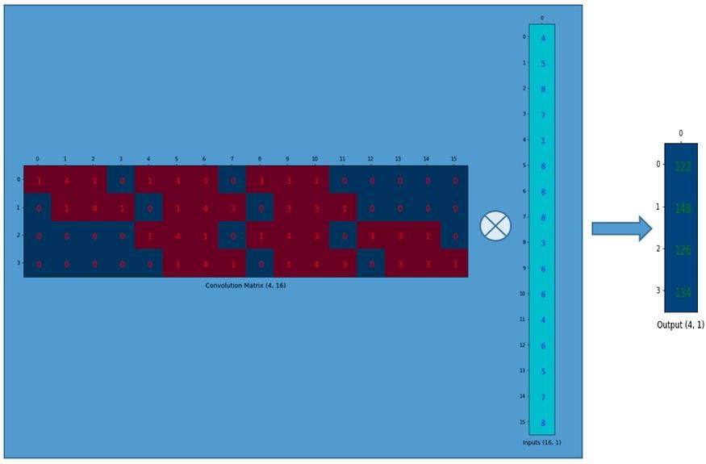
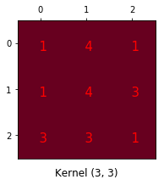
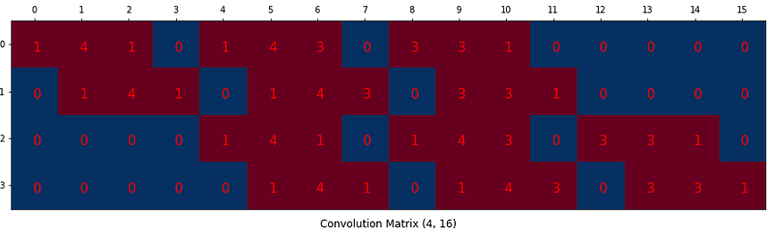
We can express a convolution operation using a matrix. It is nothing but a kernel matrix rearranged so that we can use a matrix
Convolution Matrix
multiplication to conduct convolution operations.
convolution

Slide 6
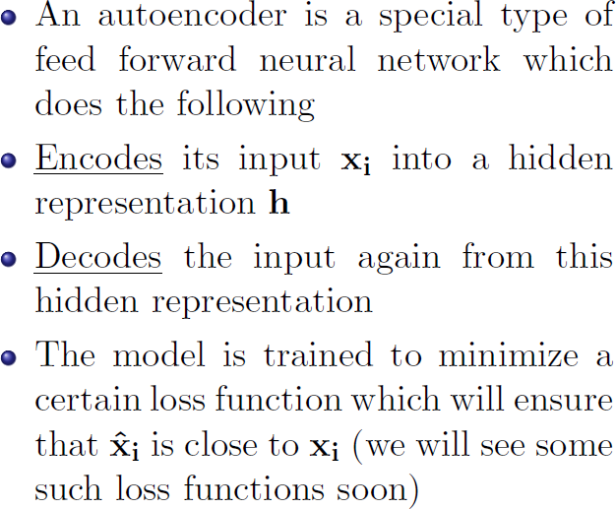
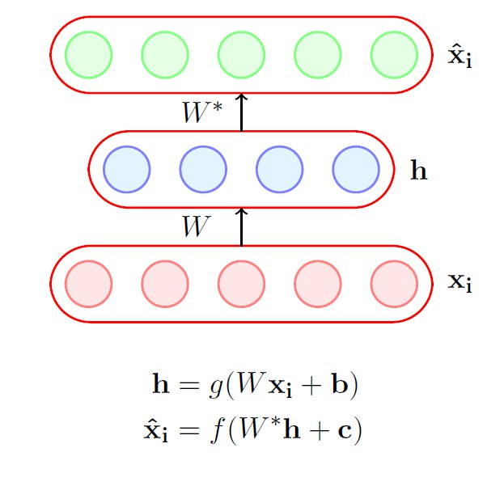
Autoencoder
latent features
Courtesy : NPTEL lectures of Dr.Mitesh Kapra

Slide 7
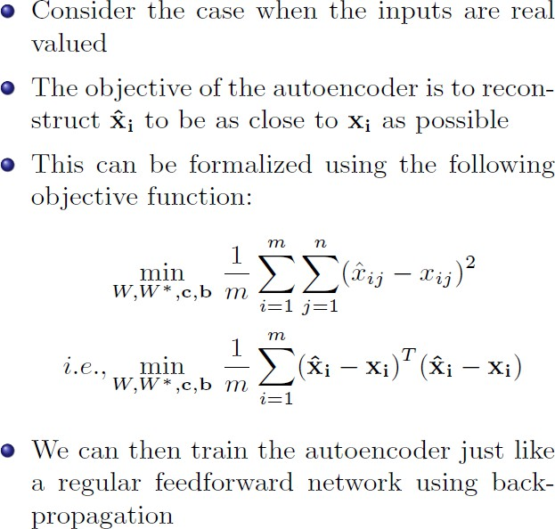
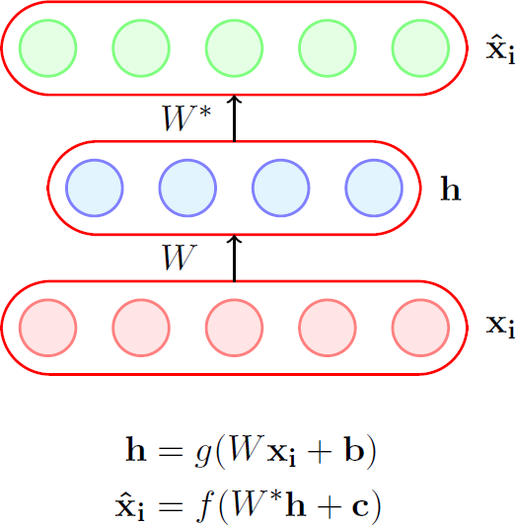
Autoencoder
latent features
Courtesy : NPTEL lectures of Dr.Mitesh Kapra

Slide 8
Types of Autoencoders
Over Complete Autoencoder
Under Complete Autoencoder
Denoising Autoencoder
Sparse Autoencoder
Variational Autoencoder

Slide 9
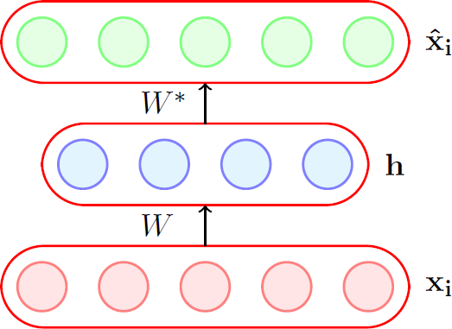

Variations of autoencoders based on the dimensionality of their latent (bottleneck) layer compared to the input layer.
Undercomplete Autoencoder:
an undercomplete autoencoder has a lower dimensionality in the latent layer compared to the input layer.
The number of neurons in the latent layer is smaller than the number of neurons in the input layer.
By limiting the capacity of the latent layer, undercomplete autoencoders are encouraged to learn a compressed representation of the input data, capturing the most salient features.
Undercomplete autoencoders are often used for dimensionality reduction, feature extraction, and anomaly detection tasks.
if we use a shallow network with a very less number of nodes, it will be very hard to capture all the relationships.

Slide 10
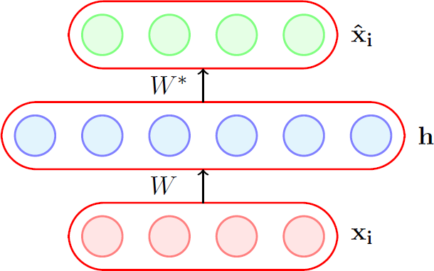

Variations of autoencoders based on the dimensionality of their latent (bottleneck) layer compared to the input layer.
Larger Number of Parameters : Overfit
Overcomplete Autoencoder:
In an overcomplete autoencoder, the dimensionality of the latent layer is higher than the dimensionality of the input layer.
This means that the number of neurons in the latent layer is larger than the number of neurons in the input layer.
Overcomplete autoencoders have more parameters and capacity to learn than the input data, which can potentially lead to overfitting.
However, they can still be useful in certain scenarios, such as feature extraction, where the autoencoder is forced to learn a representation of the input data.
Network might cheat and overfit to the input data by simply remembering the input data. In this case, we
will not be able to get the correct relationships in our encodings.

Slide 11
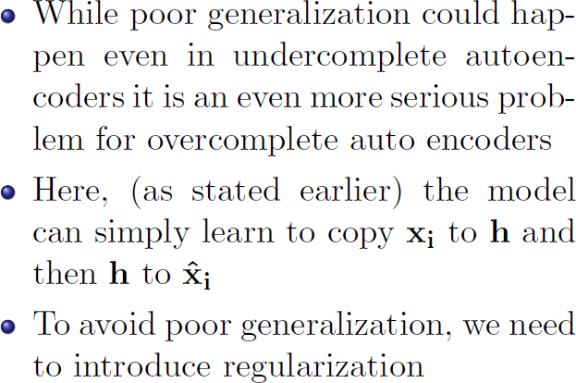
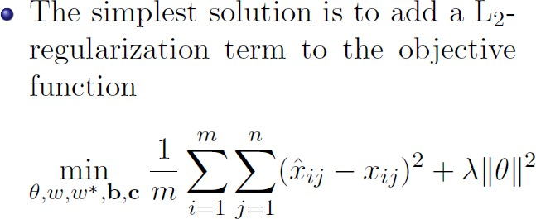
Regularisation of Autoencoders

Slide 12
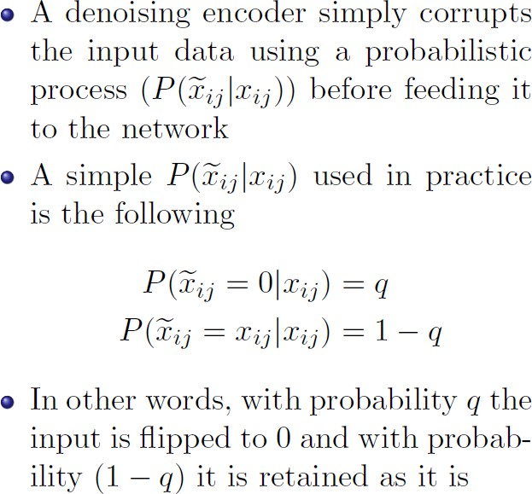
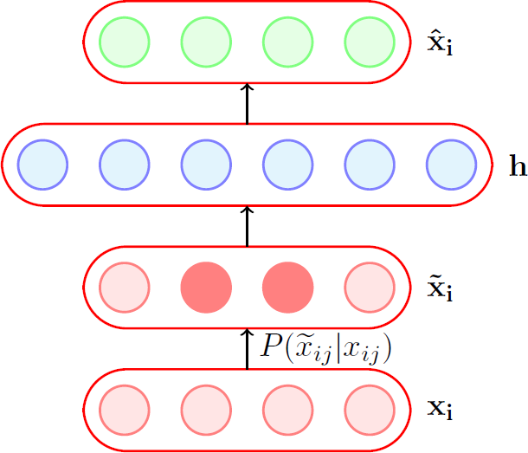
Denoising AutoEncoder
Courtesy : NPTEL lectures of Dr.Mitesh Kapra

Slide 13
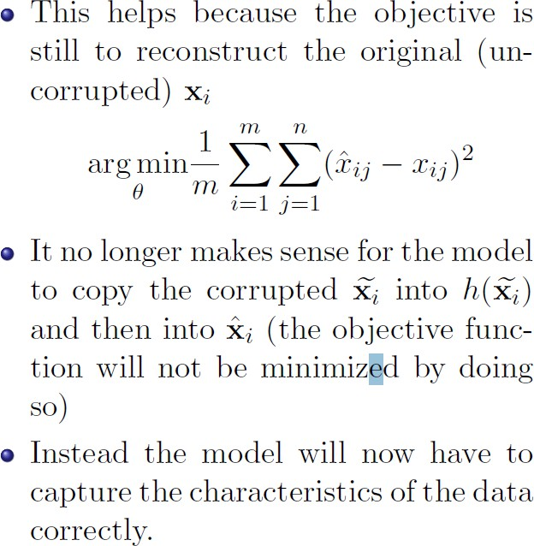
Denoising AutoEncoder

Slide 14
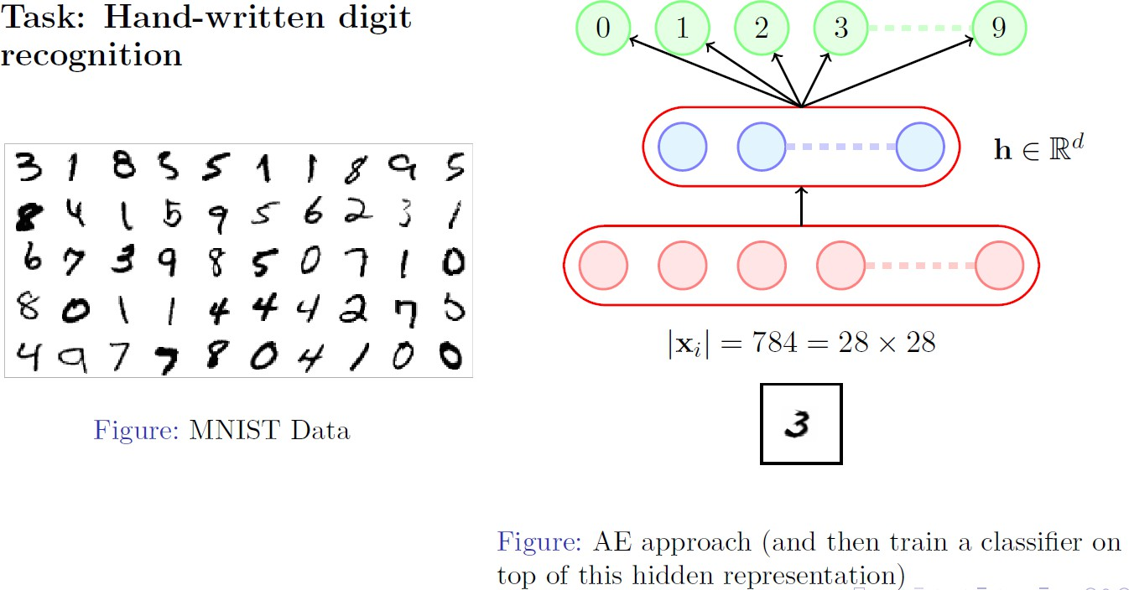
Application

Slide 15
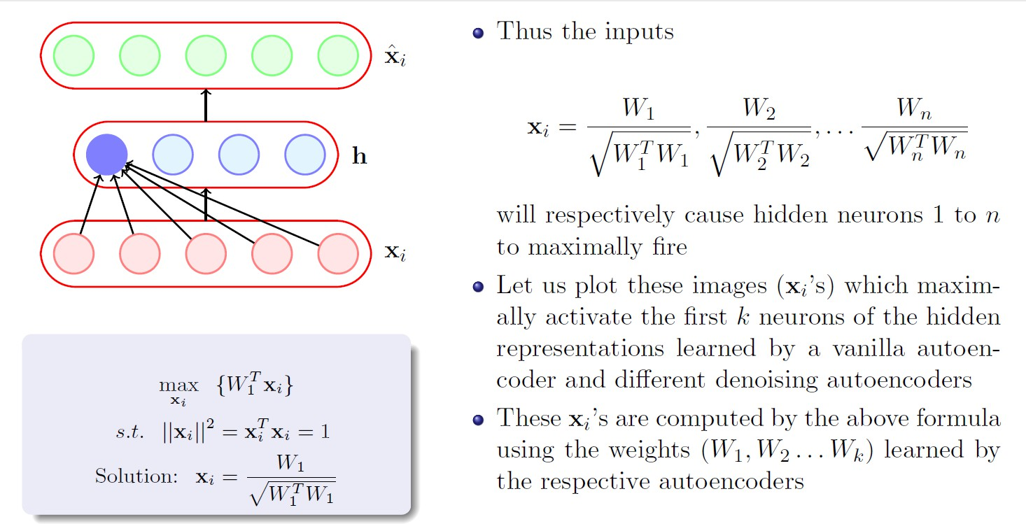
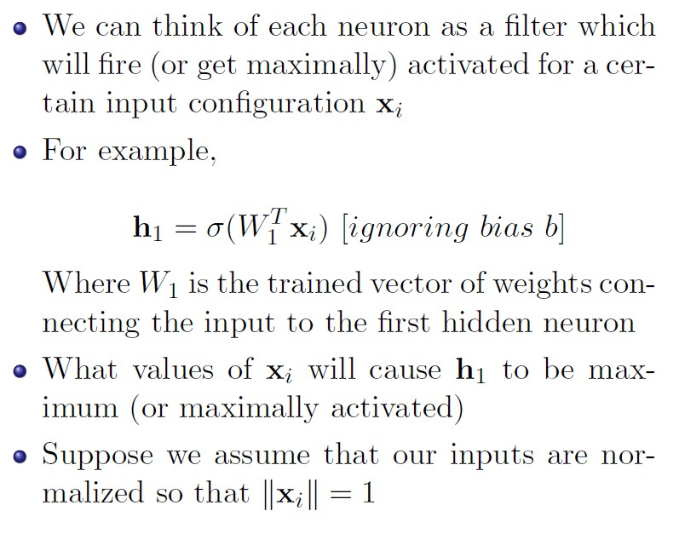

Slide 17
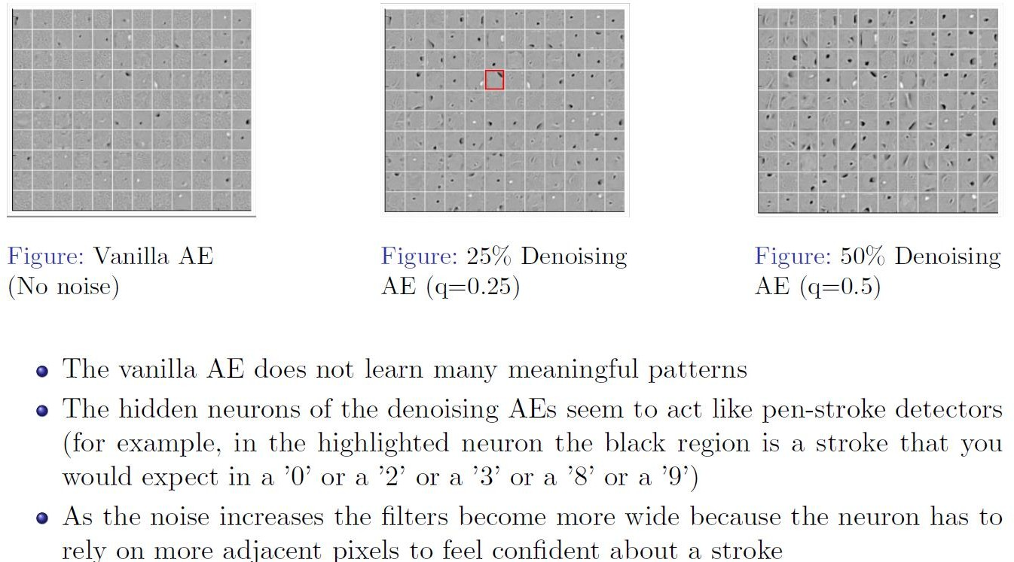

Slide 18
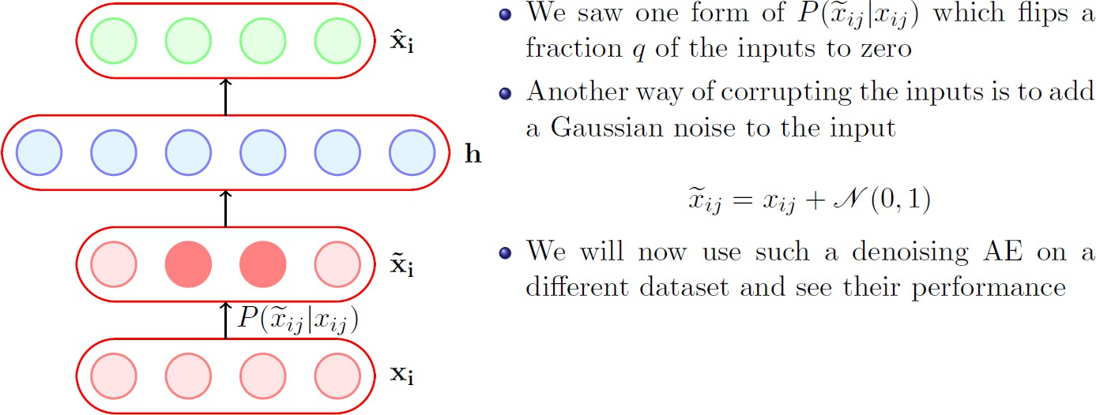
Gaussian Noise corruption

Slide 19
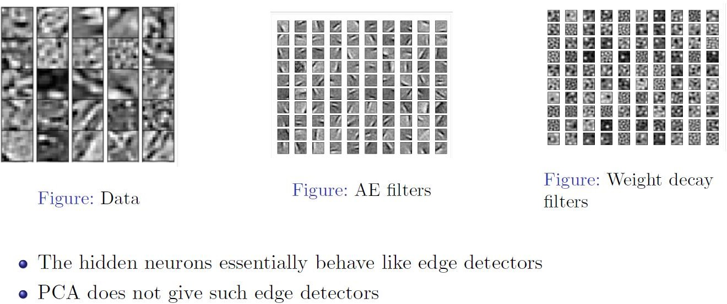

Slide 20
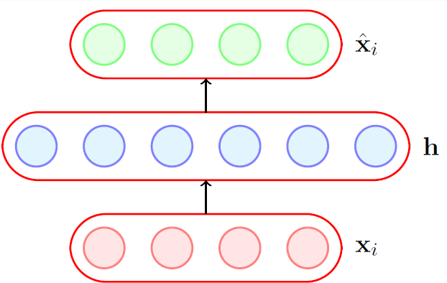
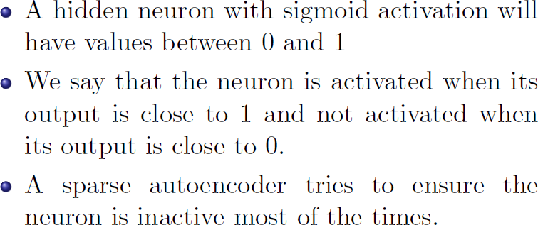
Sparse Autoencoder
Sparse autoencoders are a type of autoencoder that incorporates a sparsity constraint in the learning process. The sparsity constraint encourages the autoencoder to have a small number of active neurons, meaning only a subset of neurons are activated for each input sample. :
sparse autoencoders are useful for unsupervised feature learning tasks, such as dimensionality reduction or
pretraining deep neural networks.

Slide 21
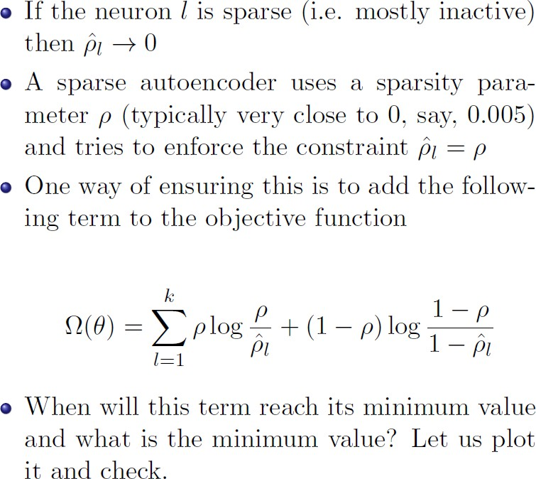
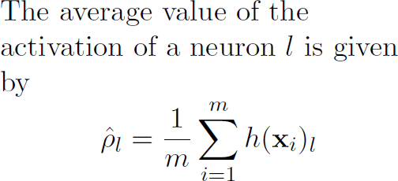
Sparse Autoencoder

Slide 22
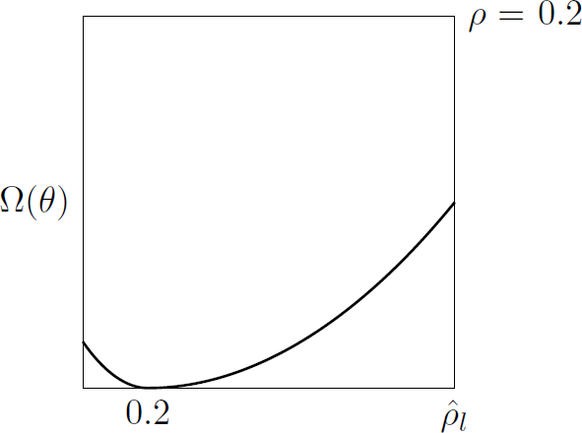
Sparse Autoencoder

Slide 23
By enforcing sparsity, the autoencoder learns to identify and capture the most salient features in the data, discarding irrelevant or redundant information. This makes sparse autoencoders useful for unsupervised feature learning tasks, such as dimensionality reduction or pretraining deep neural networks.
The sparsity constraint in sparse autoencoders can enhance their robustness to noisy or corrupted input data. By encouraging only a subset of neurons to be activated, the autoencoder learns to focus on the most informative features and filter out irrelevant or noisy information. This can improve the autoencoder's ability to denoise or reconstruct corrupted input samples.

Slide 24
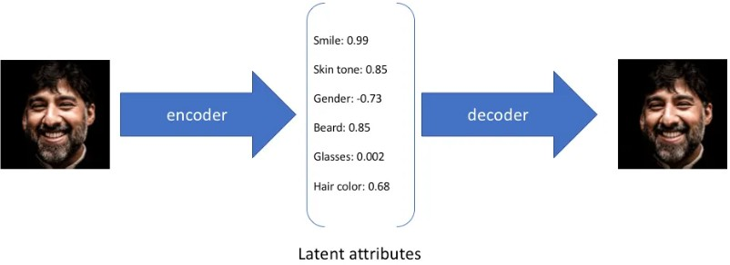
Variational Autoencoder
Basics : Lower dimensional encoding
Lower dimensional encoding? when we encode 784x1 or 28x28 dimension to a say much smaller 32x1 dimension, we basically mean that now we have 32 features which are the most important features and reflect most of the information in the data, or image. So, say for a face, when we encode a face image of say 32x32 dimension, it has the full facial two- dimensional image, now, if we encode it to 6x1 dimension, i.e, send it through a bottleneck layer of 6 nodes, we will basically get 6 features which contribute most or the major information about the facial image. Say, for the 6 features we have a smile, skin tone, gender, beard, wears glasses, and hair color.

Slide 25
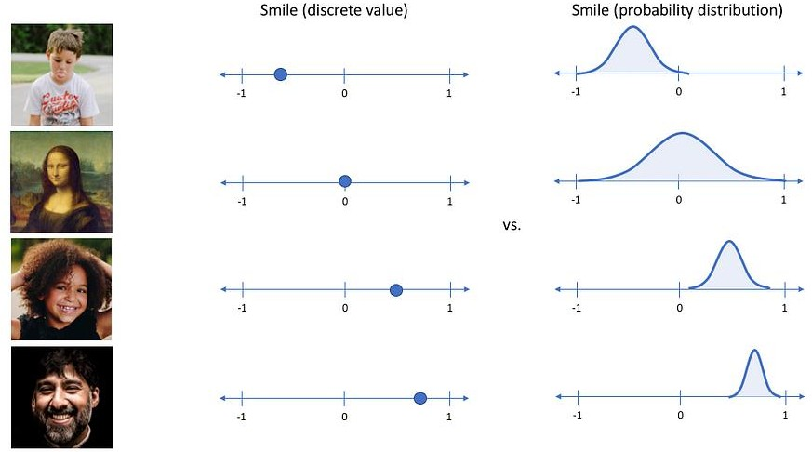
Variational Autoencoder: Latent attribute as probability distribution
We have seen that the values of the latent attributes are always discrete. This is where the variational autoencoders are different. Instead of considering to pass discrete values, the variational autoencoders pass each latent attribute as a probability distribution.

Slide 26
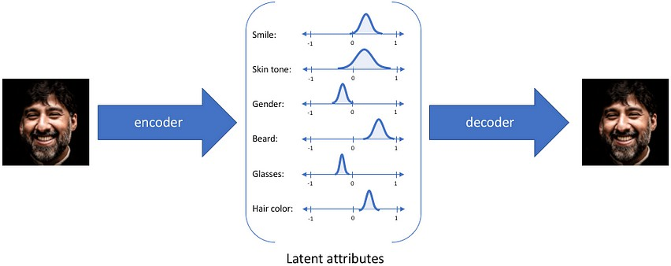
Variational Autoencoder: Latent attribute as probability distribution
We have seen that the values of the latent attributes are always discrete. This is where the variational autoencoders are different. Instead of considering to pass discrete values, the variational autoencoders pass each latent attribute as a probability distribution.
Now the representation →

Slide 27
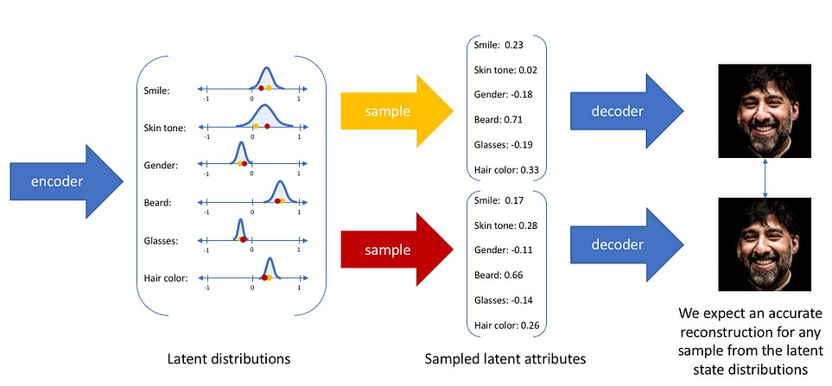
Variational autoencoders as a generative network
Now, we can see each latent attribute is passed as a probability distribution. The decoder samples from each latent distribution and decodes to reconstruct the image. So, as the sampling is random and not backpropagated the reconstructed image is similar to the input but is not actually present in the input set. This is the reason for variational autoencoders to be known as a generative network.
Now, to create a distribution for each latent vector, the encoder in place of passing the value, pass the mean and standard deviation of the distribution, which is used to create construct the normal distribution.

Slide 28
Applications

Slide 29
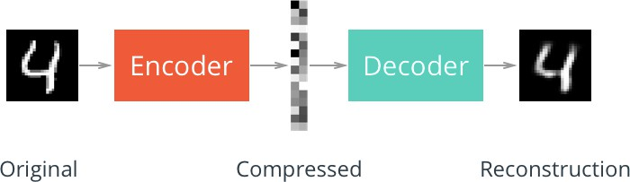
Autoencoder for Image File Compression ( Dimensionality Reduction)
Using Autoencoders we can compress image files which are great for sharing and saving in a faster and more memory efficient way. These compressed images contain the key information same as in original images but in a compressed format that can be used further for other reconstructions and transformations.

Slide 30
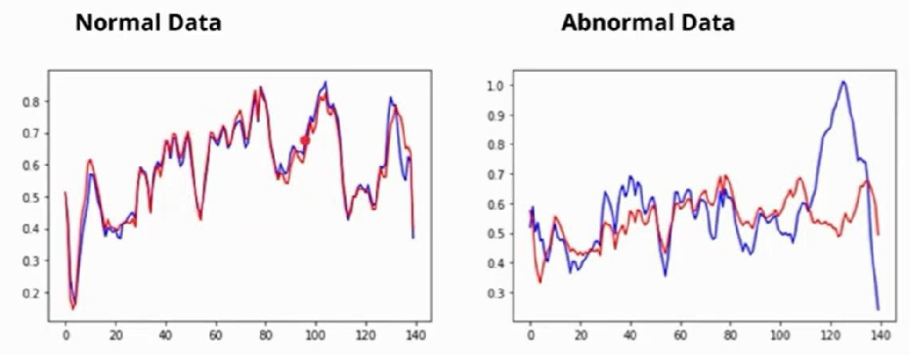
Autoencoders are used largely for anomaly detection:
Autoencoders create encodings that basically captures the relationship among data. Now, if we train our autoencoder on a particular dataset, the encoder and decoder parameters will be trained to represent the relationships on the datasets the best way. Thus, will be able to recreate any data given from that kind of dataset in the best way. So, if data from that particular dataset is sent through the autoencoder, the reconstruction error is less. But if some other kind of data is sent through the autoencoder it will generate a huge reconstruction error. If we are able to apply a correct cutoff we will be able to create an anomaly detector.

Slide 31
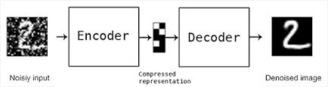
Autoencoders are used for Noise Removal
If we can pass the noisy data as input and clean data as output and train an autoencoder on such given data pairs, trained Autoencoders can be highly useful for noise removal. This is because noise points usually do not have any correlations. Now, as the autoencoders need to represent the data in the lowest dimensions, the encodings usually have only the important relations there exists, rejecting the random ones. So, the decoded data coming out as output of an autoencoder is free of all the extra relations and hence the noise.

Slide 32
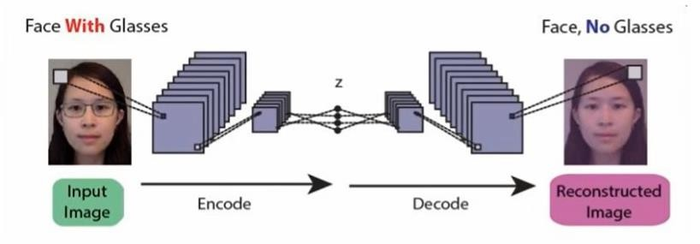
Autoencoders as Generative models:
Before the GAN’s came into existence, Autoencoders were used as generative models. One of the
modified approaches of autoencoders, variational autoencoders are used for generative purposes.
Image Reconstruction
The convolutional Autoencoder learns to remove noise from a picture or reconstruct the missing parts, so the input noisy version becomes the clean output version. The network also fills the gap in the image.

Slide 33
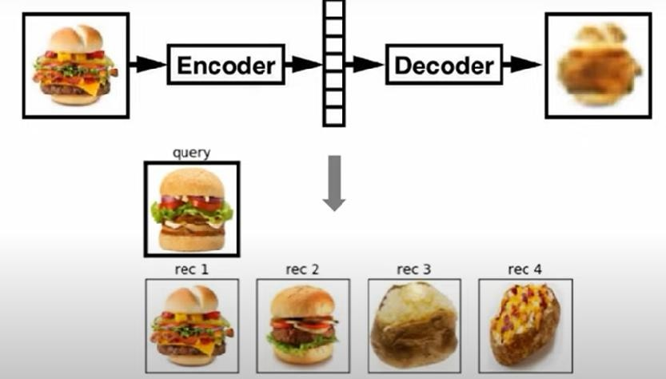
Image Search
Image Search – Deep autoencoders can compress images into 30 number vector images. Image search becomes a matter of application where a search engine will compress an image and compare the vector to index and translate to a matching image.

Slide 34
Training of AutoEncoders- Hyper parameters
There are four significant hyperparameters that we need to set before training them.
Code Size represents the number of nodes in the middle layer—the smaller size results in more compression.
Number of Layers – The Autoencoder can be as deep as we want to be.
Loss function – To update the weights, we must calculate the loss, which we need to minimize using optimizer and weight updation. Mainly mean squared error and binary cross-entropy. The input value is 0-1; then, we use cross-entropy. Otherwise, we use mean squared error.
Number of nodes per layer – the number of nodes decreases with each subsequent encoder layer and increases back in the decoder.

